Slide 1




Family and
Festivals
By Sanskriti
www.vaagaacademy.com

Slide 2


WHAT IS FAMILY?
A family is a group of people related by blood, love, and care.
Families: •Love and support us •Celebrate and live together •Teach us good habits
Olympiad Tip: A family is our first school!

Slide 3




Types of family
Type of Family Nuclear
Joint
Who Lives in It Parents and their children Grandparents, uncles,
aunts too
Family living in other
homes
People who take care of a
child
Example Mom, Dad, You
Big Indian family
Extended
Uncle in another city
Foster/Adopted
Special love family
Olympiad Clue:
Living with grandparents =
Joint Family

Slide 4
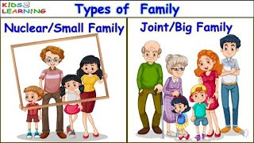

Slide 5







FAMILY MEMBERS
Member Grandmother
Grandfather
Who They Are To You Mom's or Dad’s mother
Mom's or Dad’s father
Aunt Uncle
Mom’s or Dad’s sister Mom’s or Dad’s brother
Children of your uncle or
aunt
Cousins
Olympiad Example:
If Jenny is David’s mother’s sister → Jenny is David’s
Aunt

Slide 6
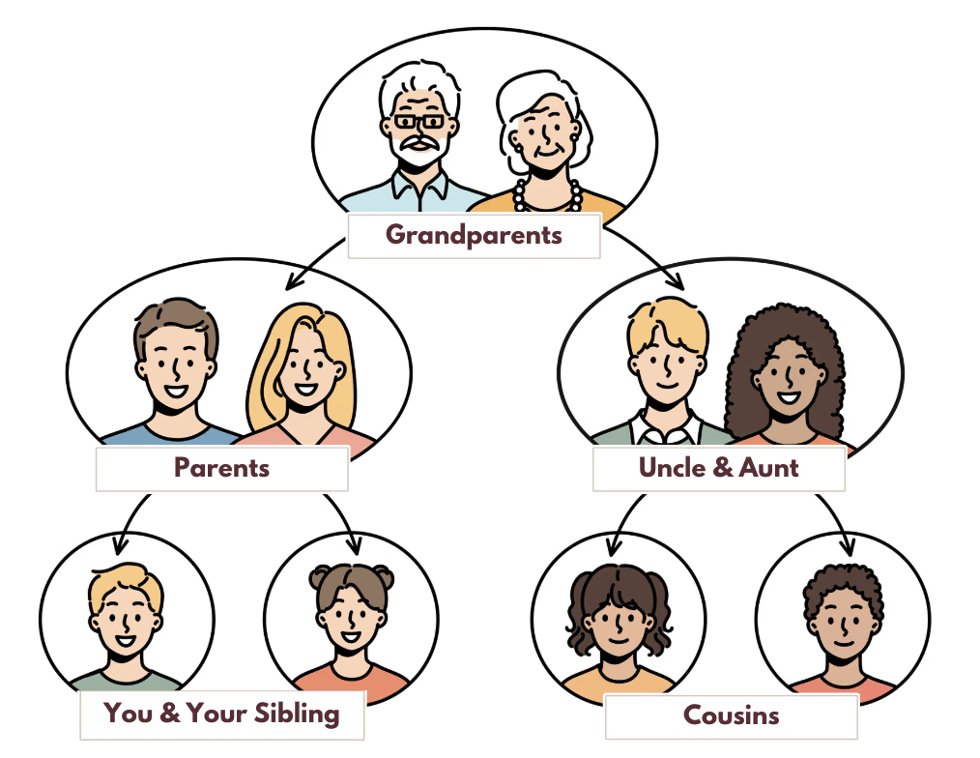

Slide 7

Why Families Are Important
•Teach us manners and respect •Celebrate festivals and birthdays •Help when we’re sick or sad •Make us feel safe and loved
Olympiad HOTS: Playing with your uncle’s kids = playing
with your cousins

Slide 8
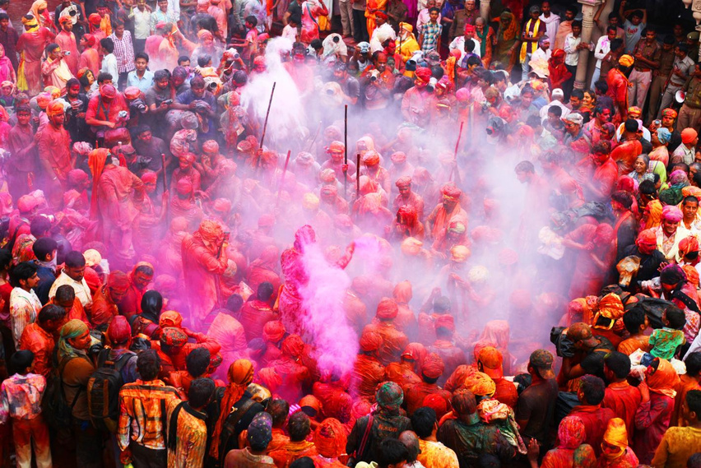

What Are Festivals?
Festivals are special days we celebrate with family and friends. We: •Wear new clothes •Eat special food •Share happiness and gifts
Festivals bring people together!

Slide 9




Types of festivals
Type Religious
Examples Diwali, Christmas,
Eid, Gurpurab
Independence Day,
Republic Day
Why It’s Celebrated Based on
faith/tradition
For our country’s
pride
National
Harvest
Pongal, Bihu, Onam, Celebrate crops and
Lohri
Birthday, Rakhi,
Children’s Day
farmers Personal and fun times
Cultural/Fun
Olympiad Insight:
Diwali = Festival of
lights
, Pongal =
harvest
festival

Slide 10
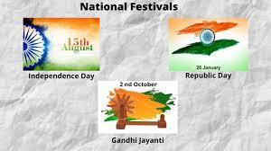

Slide 11
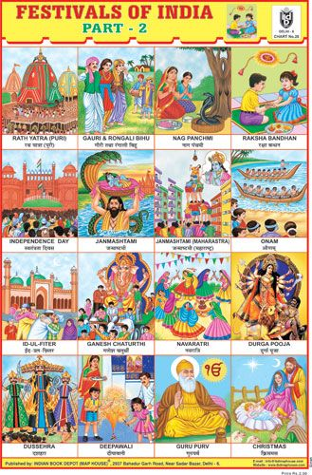

Slide 12






Festival & Family Together
During festivals: •We decorate the house •Light diyas or candles •Eat sweets and wear new clothes •Pray and enjoy time with family •Share joy with friends & neighbors
Olympiad Tip: Christmas is celebrated on
25th December

Slide 13
Month | Festival | Date | Day
January | Makarsankranti or Pongal | 14 January 2025 | Wednesday
February | Vasant Panchami | 02 February 2025 | Sunday
February | Thaipusam | 11 February 2025 | Tuesday
February | Maha Shivaratri | 26 February 2025 | Wednesday
March | Holika Dahan | 13 March 2025 | Thursday
March | Holi | 14 March 2025 | Friday
March | Hindi New Year | 29 March 2025 | Saturday
March | Ugadi or Gudi Padwa or Telugu New Year | 30 March 2025 | Sunday
April | Ramanavami | 06 April 2025 | Sunday
April | Hanuman Jayanti | 12 April 2025 | Saturday
April | Vaisakhi or Baisakhi or Vishu | 14 April 2025 | Monday
April | Bengali New Year or Bihu | 14 April 2025 | Monday
April | Tamil New Year | 14 April 2025 | Monday
May | Akshaya Tritiya | 30 May 2025 | Friday
May | Buddha Purnima | 11, May, 2025 | Sunday
June | Jagannath Rathyatra | 27, June, 2025 | Friday
July | Guru Purnima | 10 July,2025 | Thursday
August | Raksha Bandhan | 9 August, 2025 | Saturday
August | Janmasthami | 16 August,2025 | Saturday
August | Ganesh Chaturthi | 26 August, 2025 | Tuesday
September | Onam | 5 September,2025 | Friday
September | Durga Ashtami | 30,September,2025 | Tuesday
October | Dussehra | 2 October,2025 | Thursday
October | Diwali | 20 October,2025 | Monday
October | Govardhan Puja | 22 October,2025 | Wednesday
October | Chhath Puja | 27 October,2025 | Monday
November | Gurpurab | 5 Nov, 2025 | Wednesday
December | Christmas | 25, December, 2025 | Thursday

Slide 14
January:
Republic Day: January 26th
Indian Army Day: January 15th
March:
International Women's Day: March 8th
August:
Independence Day: August 15th
October:
Gandhi Jayanti: October 2nd

